Slide 1
Intermediate Programming Topics

Slide 2
Scope
Scope is somewhat a measure of where a variable “exists”
It is a hierarchical structure, consisting of three environments:
Python’s built-in libraries
Global
Local
Variables can only be accessed upwards in the hierarchy

Slide 3
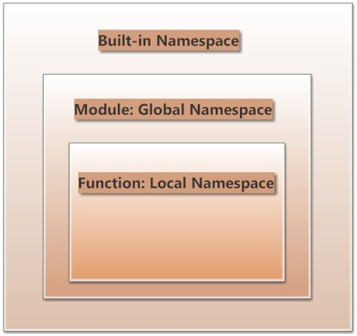
http://www.programiz.com/sites/tutorial2program/files/DiffScope.jpg
Notes:
http://www.programiz.com/sites/tutorial2program/files/DiffScope.jpg

Slide 4
Recursion
A recursive function is one which calls itself:
def fib(x):
if x <= 2:
return 1
else:
return fib(x-1) + fib(x-2)

Slide 5
Recursion
Recursion is sometimes inefficient, but certain problems are *much* easier using recursion
Can you think of a recursive model we’ve used?

Slide 6
Base Case vs. Step Case
def fib(x):
if x <= 2:
return 1
else:
return fib(x-1) + fib(x-2)

Slide 7
Scope + Recursion
fib(4)

Slide 8
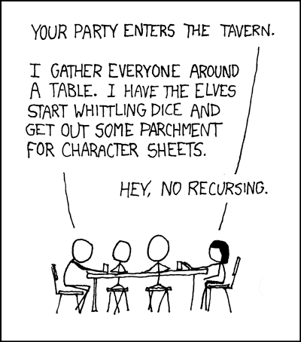
Let’s Recurse!

Slide 10
Are There Issues Here?
def fib(x):
if x <= 2:
return 1
else:
return fib(x-1) + fib(x-2)

Slide 11
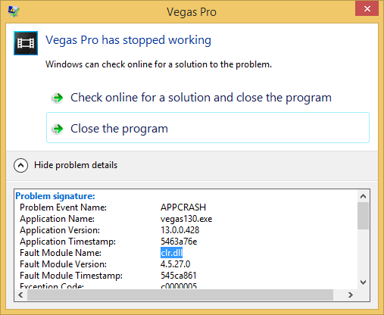
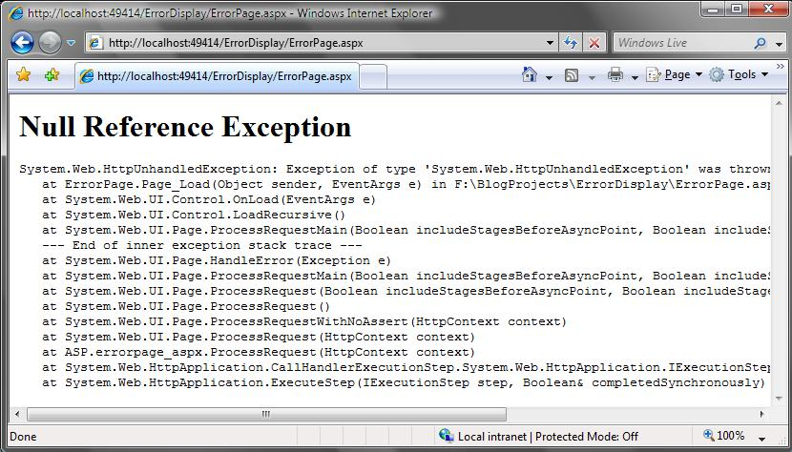
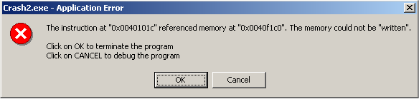
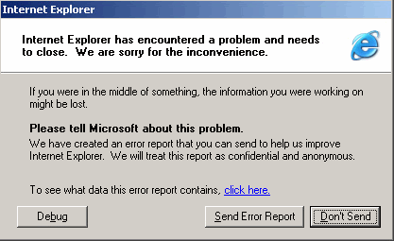
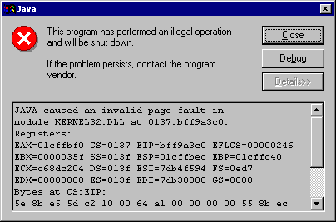

Slide 12
Unhandled Exceptions
Unhandled exceptions cause your script to abort
Potential for memory leaks and leaving open connections
Look very bad to users

Slide 13
Try / Except
Place code which may raise exceptions inside of a try block
Catch exceptions with an except block
With an except block, you can:
Retry a failed action (ask user for new input)
Inform user of an irreconcilable problem (database is unavailable)
Fail gracefully (Record logs to help discover the issue)

Slide 14
Finally!
The finally block will run whether an exception is raised or not
This is often used to close files, database connections, etc.

Slide 15
With
The with statement creates some resource for the duration of the block, and then automatically disposes of it afterwards

